Slide 1

Automated robust first peak detection in a time signal using computational intelligence
Computational Intelligence
Prof. Andreas Pech
Presented by
Susmita Sumaiya
Kazi Md Abdullah Al Mubin
Aishin Abdulla Yoosufali

Slide 2
Overview
Introduction
Signal Processing Approach (Library and Functions)
First peak detection in Signal Processing Approach
Machine Learning Approach(Library and Functions)
First peak detection in Machine Learning Approach
Noise filtering
GUI
Output

Slide 3
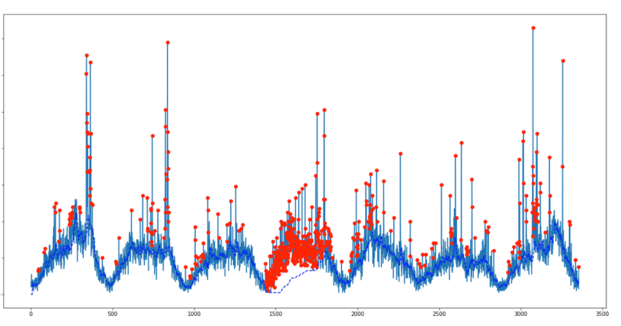
Introduction
Peak detection in a signal is a familiar requirement in scientific data processing to measure their positions, heights, widths, and/or areas.
For signal processing applications using computational intelligence, peak detection is an important step.

Slide 4
Signal Processing Approach (Library and Functions)
In our model, for detecting the first peak of the signal we used SciPy library.
The SciPy library depends on NumPy, which provides convenient and fast N-dimensional array manipulation. The SciPy library is built to work with NumPy arrays, and provides many user-friendly and efficient numerical routines such as routines for numerical integration and optimization.

Slide 5
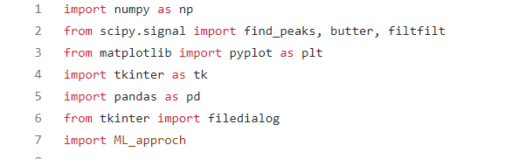
Signal Processing Approach (Library and Functions)
scipy.signal.find_peaks
This function takes a 1-D array and finds all local maxima by simple comparison of neighboring values. Optionally, a subset of these peaks can be selected by specifying conditions for a peak’s properties.

Slide 6
Signal Processing Approach (Library and Functions)
pandas as pd
pandas is a Python package providing fast, flexible, and expressive data structures designed to make working with “relational” or “labeled” data both easy and intuitive.
In our given test file, there is some string values. We use pandas to convert all the values to float64

Slide 7
Signal Processing Approach (Library and Functions)
tkinter as tk
The tkinter package (“Tk interface”) is the standard Python interface to the Tcl/Tk GUI toolkit.
tkinter import filedialog
This function offers a dialog that can be used while working with files.
We used this package to create Graphical User Interface for uploading our test file.

Slide 8
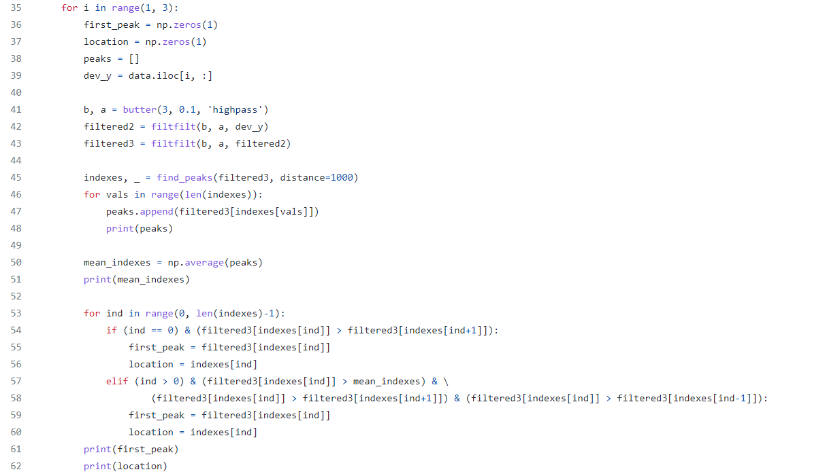
First Peak Detection in Signal Processing Approach

Slide 9
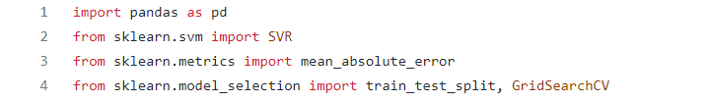
Machine Learning Approach (Library and Functions)
As our second approach we used Scikit-learn library.
Scikit-learn is an open source data analysis library, and the gold standard for Machine Learning (ML) in the Python ecosystem
The sklearn.svm module includes Support Vector Machine algorithms.
The sklearn.metrics module includes score functions, performance metrics and pairwise metrics and distance computations.

Slide 10
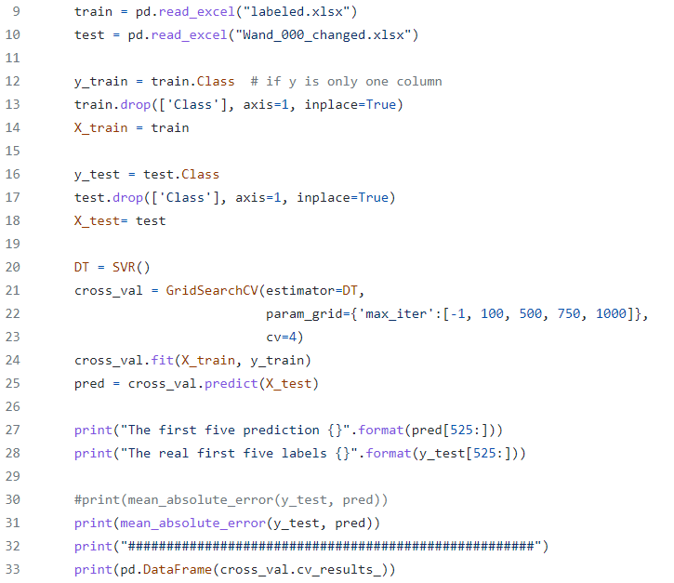
First Peak Detection in Machine Learning Approach

Slide 11

Noise Handling
scipy.signal.filtfilt
This function applies a linear digital filter twice, once forward and once backwards. The combined filter has zero phase and a filter order twice that of the original.
scipy.signal.butter
Design an Nth-order digital or analog Butterworth filter and return the filter coefficients.

Slide 12
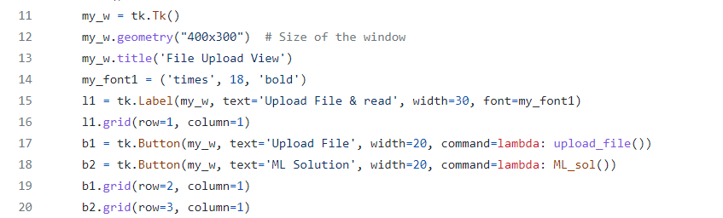
GUI
For the input, we used a GUI in our model.

Slide 13
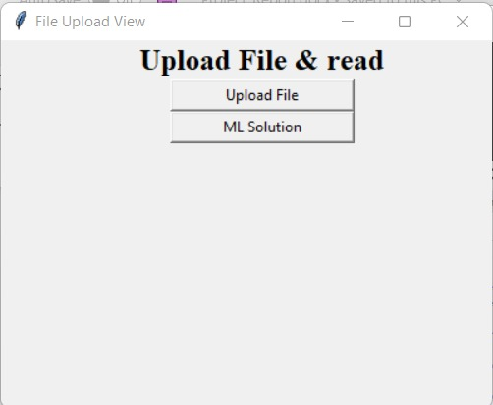
GUI
This button is used for uploading the test file
This button is used for viewing the prediction using machine learning solution.

Slide 14
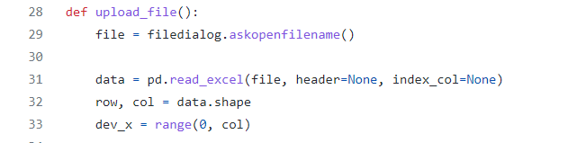
GUI
For uploading, we used the function askopenfilename() that cope the location of the file.
pandas.read_excel is used to read from a local filesystem or URL. It Supports xls, xlsx, xlsm, xlsb, odf, ods and odt file extensions.

Slide 15
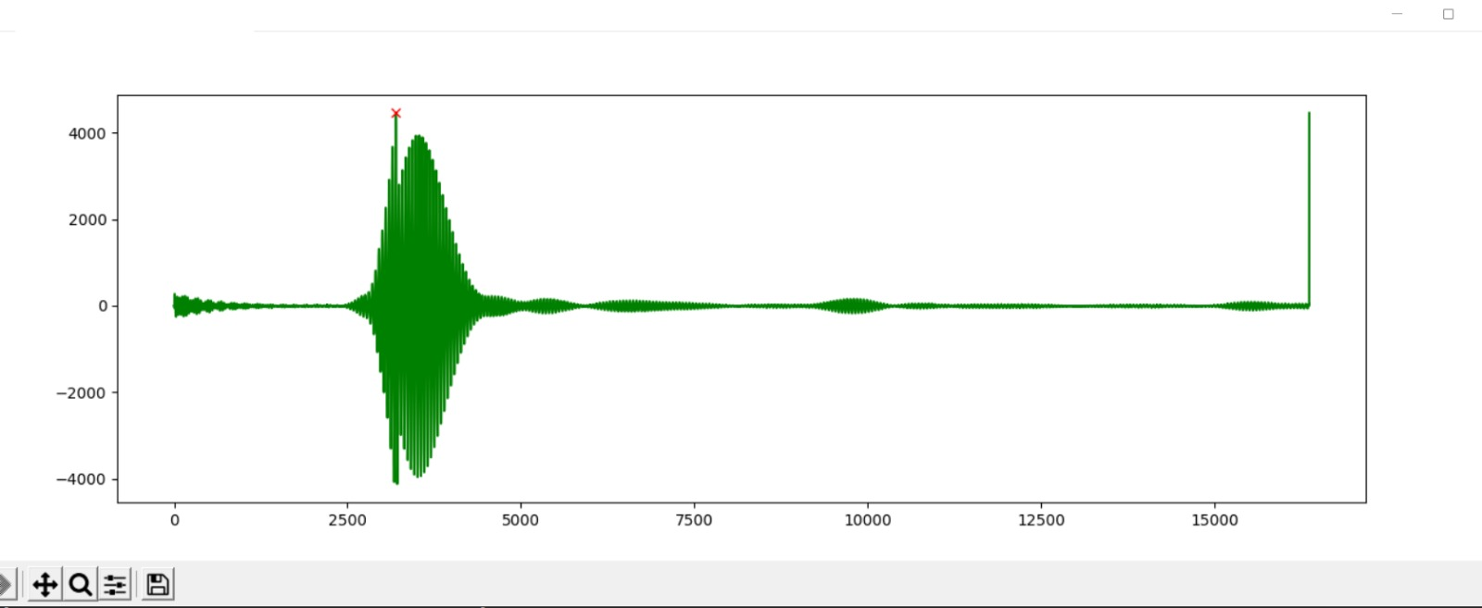
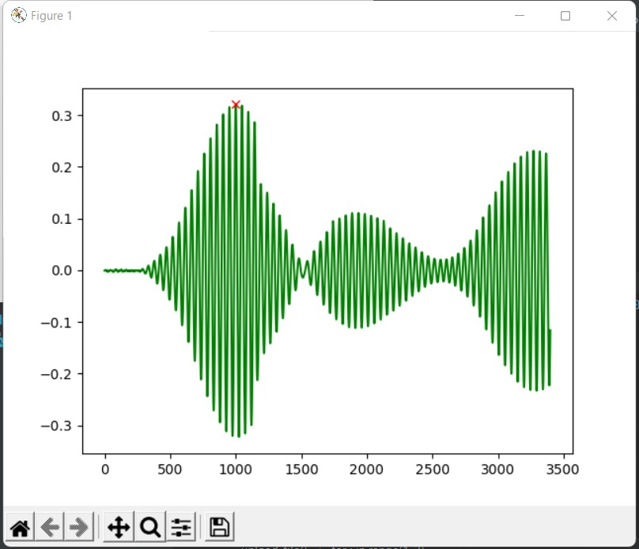
Output (first peak detection in noisy signal)

Slide 16
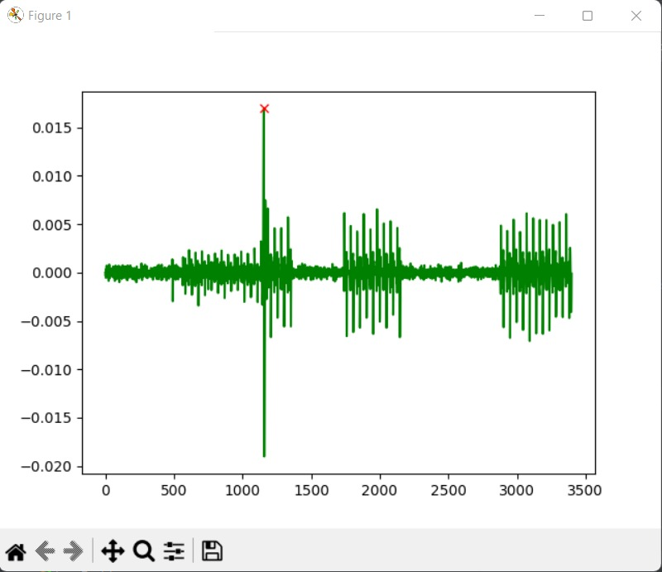
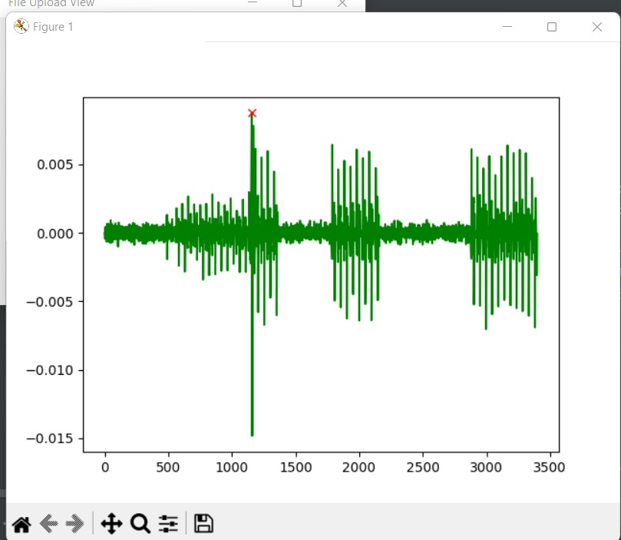
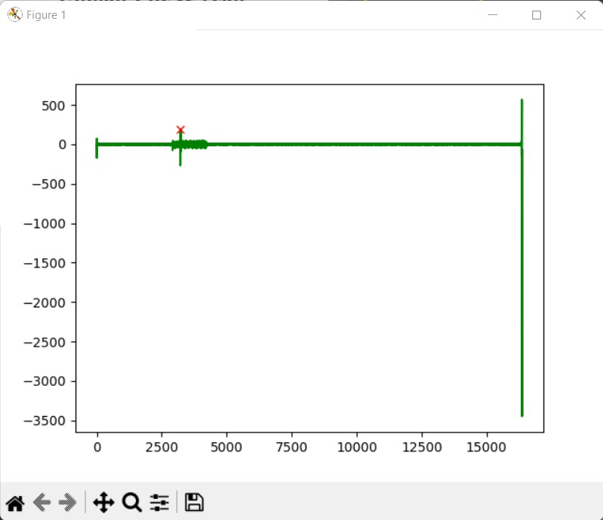
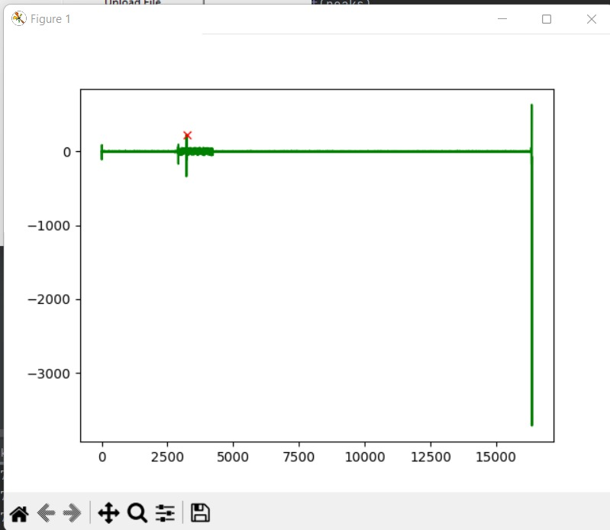
Output (first peak after noise filtering)

Slide 17
Question?

